Slide 1
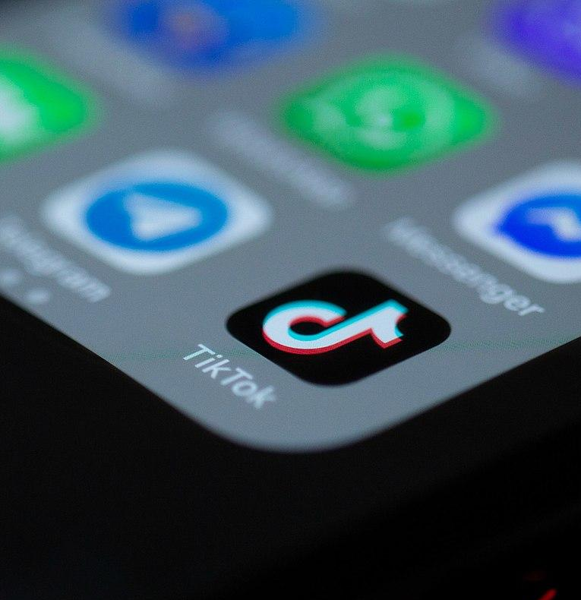
The counterbalance to freedom of expression is responsibility in expression
S3 Active citizenship and the media
Figure: Solen Feyissa (CC-SA-2.0)

Slide 2
Social media both supports and endangers democracy
Social media can support democracy: the basis of democracy is everyone’s right to participate in joint discussion, the development of society, and the defence of values that are important to them.
Social media can jeopardise democracy: in social media, the greatest power is exercised by those whose content is distributed the most widely.

Slide 3
We all wield power on social media
The operations of traditional media are guided by good journalistic practice and legislation.
On social media, users create their own unwritten rules for what is OK online and what is not.
We can all influence these rules: every shared link, reaction, comment and occasion of not commenting wields power in the media and creates a shared public atmosphere.
In addition to freedom of expression, we also talk about responsibility in expression.

Slide 4
Stop and reflect
As human rights defender Martin Luther King Jr. famously said, “The greatest tragedy of this period of social transition was not the strident clamor of the bad people, but the appalling silence of the good people."
How does this relate to media power and the responsibility of every social media user?

Slide 5
Freedom of expression does not prevail over other fundamental rights
The Constitution of Finland guarantees freedom of expression as a fundamental right for everyone: everyone is allowed to express, publish and receive opinions, information and other messages without anyone preventing them in advance.
Freedom of expression has limits. Legislation is a whole: freedom of expression is a fundamental right, but its use cannot violate other fundamental rights, such as equality.
The Criminal Code restricts freedom of expression by making, for example, defamation, dissemination of information that violates personal privacy and ethnic agitation punishable offences.

Slide 6
Stop and reflect
The recommendation of the Committee of Ministers of the Council of Europe defines hate speech as follows: “Hate speech shall be understood as covering all forms of expression which spread, incite, promote or justify racial hatred, xenophobia, anti-Semitism or other forms of hatred based on intolerance.”
Where do you think the boundary lies between speaking in the name of freedom of expression and speech that can be interpreted as hate speech?

Slide 7



Last revised 7 March 2024

